Slide 1
CASA0003: Group Mini Project
City Transformation
By Group 9:
Mengqing Zhao
Junkai Ding
Yujie Lyu
Zeqiang Fang Video Link: https://web.microsoftstream.com/video/56de5776-0db6-49bc-94ee-775f182de0bf Backup Video Link: https://github.com/fang-zeqiang/Digital-Viz-City-Transformations/blob/main/Video/Group9-Pre-for-Stream.mkv Github Repo: https://github.com/fang-zeqiang/Digital-Viz-City-Transformations

Slide 2

What has city of Toronto done to improve the urban cycling experience?
Notes:
toronto cycling background

Slide 3
Storyline
1. Problem: Toronto Bicycle Theft
2. Solution: Parking Infrastructure
3. Future Mobility: Bike Share
Notes:
The main storyline

Slide 4
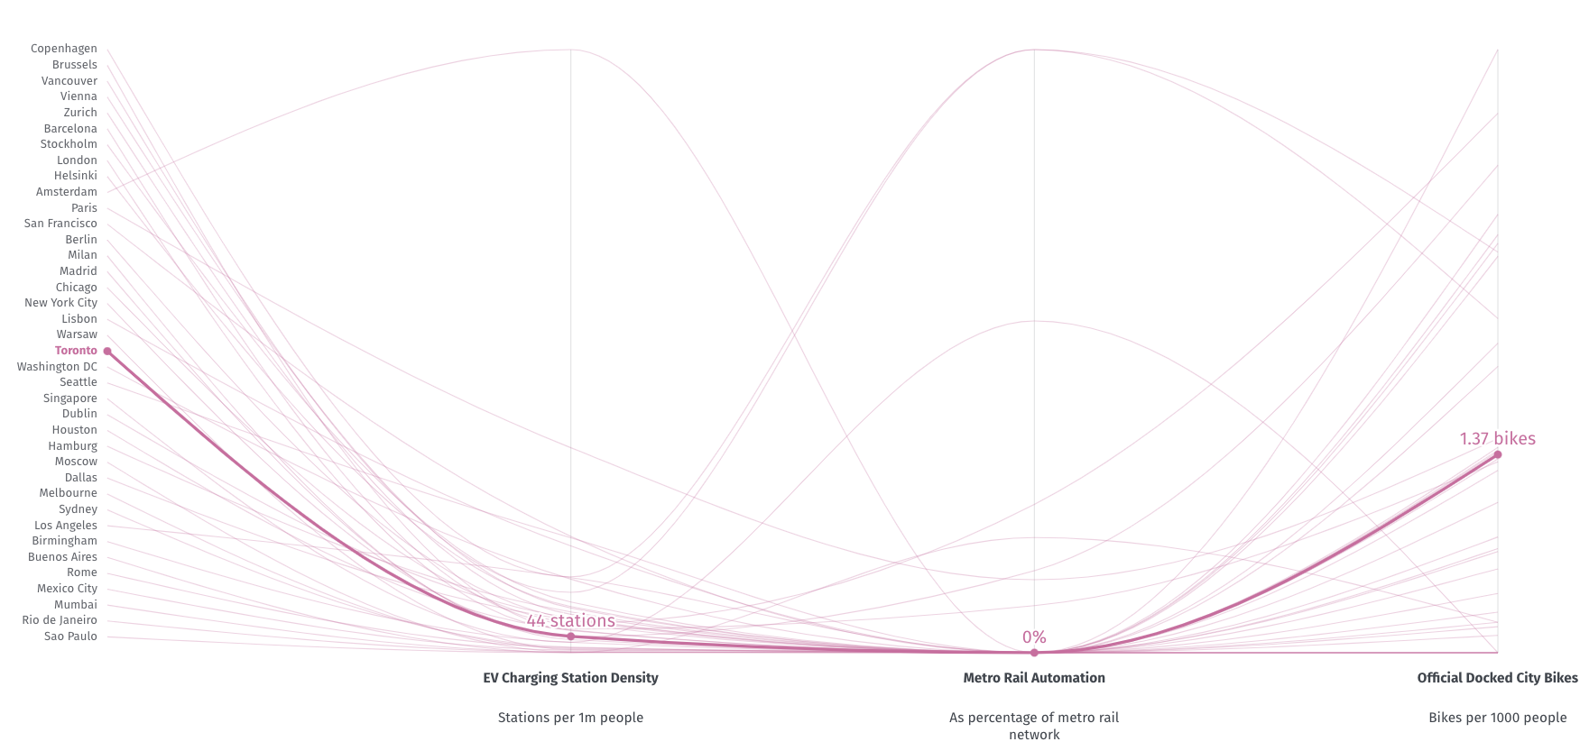
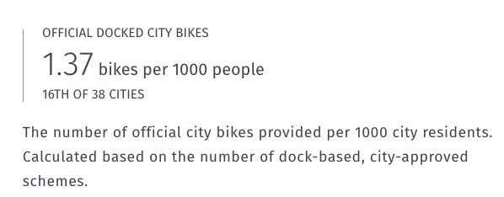
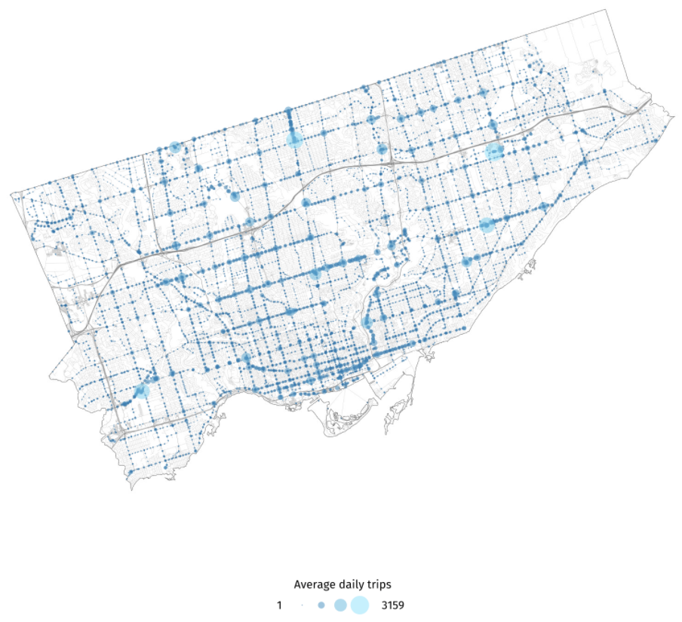
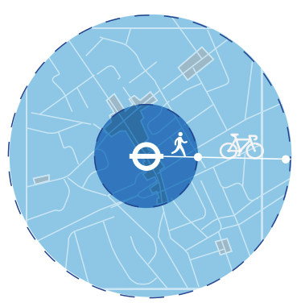
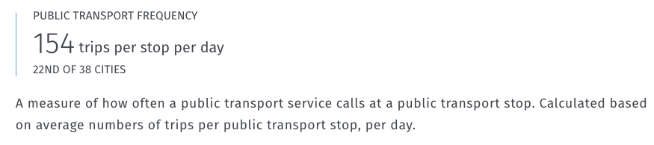
Why Toronto？
Bike More important role
Improved cycling infrastructure in Toronto
Public transport has a wider reach
the average distance cycled to Toronto public
>
the average distance walked
(ibid, 2021)
(Toronto Urban Mobility Index, 2021)
Notes:
toronto cycling background：
In the right diagram, you can see:
There are about 1.4 bikes per 1000 people in the city of Toronto, which rank the sixteenth among the main big cities in the world
Bikes have become more and more important in the city of Toronto
As you can see in the left map, public transport in Toronto can make 154 trips per stop per day, which rank 22th among the main cities as mentioned
you can see this distance circle picture,
Toronto’s Public transport has a wider reach because of the Improved cycling infrastructure in Toronto.
According to the research, the average distance cycled to Toronto public can be much greater than the average distance walked

Slide 5
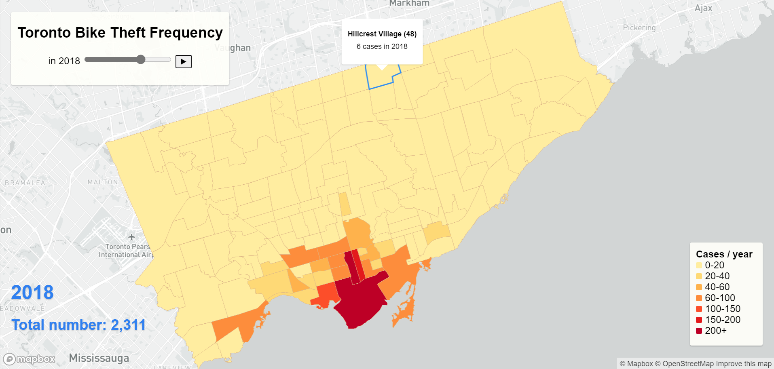
1. Bicycle Theft Risk Change
Toronto Bike Theft Frequency

Slide 6
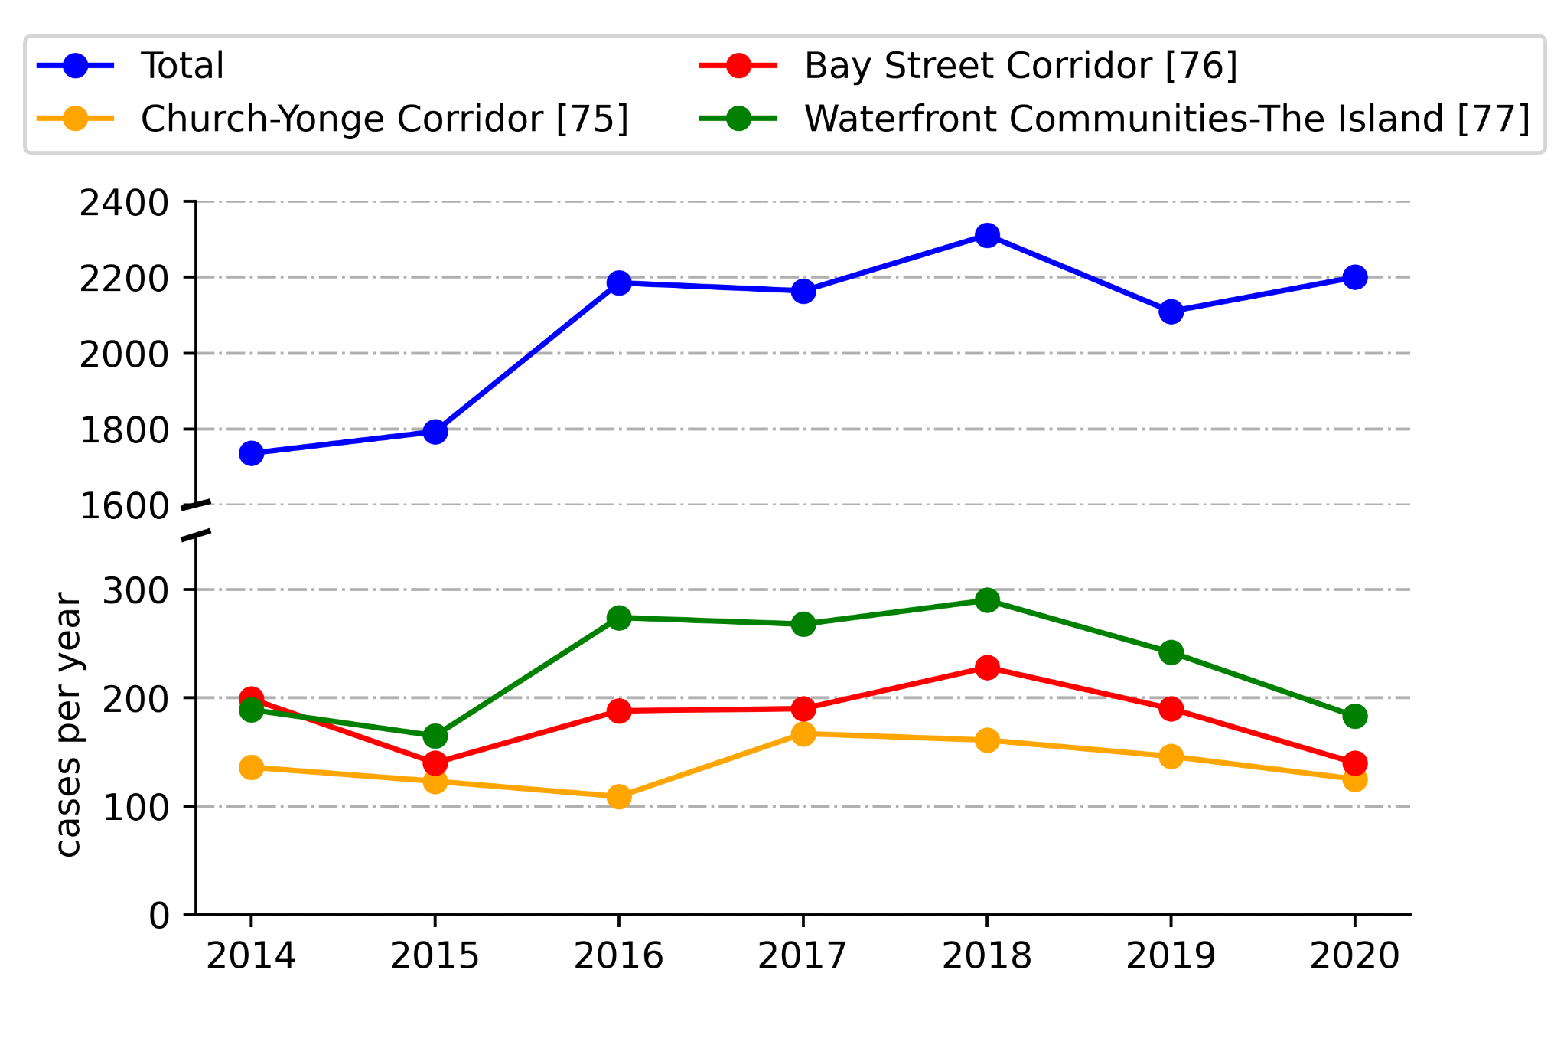
1. Bicycle Theft Trend
The overall trend is upward.
- Bike use in Toronto is increasing.
- Lack of locking stations for bikes.
A rebound in 2020
- COVID-19 caused an increase in cycling.
- More inexperienced new cyclists.
Decrease in the core areas in the last two years
- Government policies and suggestions.
Notes:
In the website, you may need a background sentences
Bikeways - Datasets - CKAN (prod-toronto.ca)

Slide 7
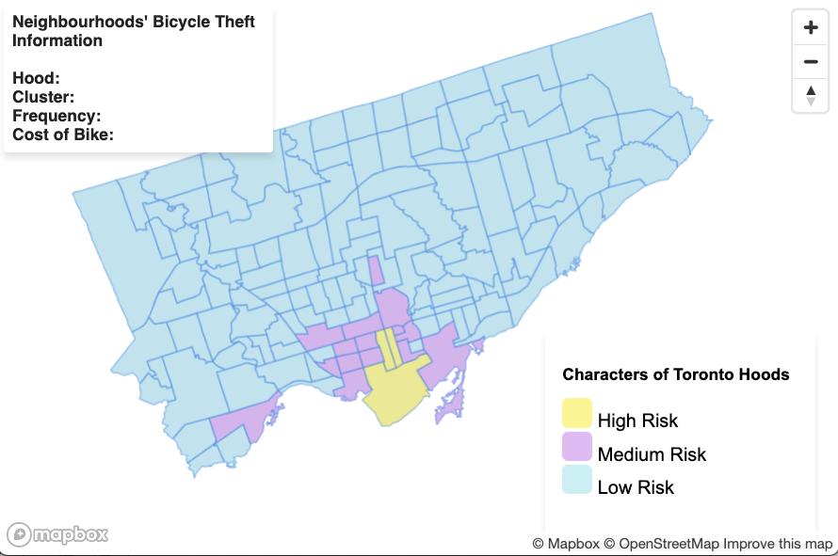
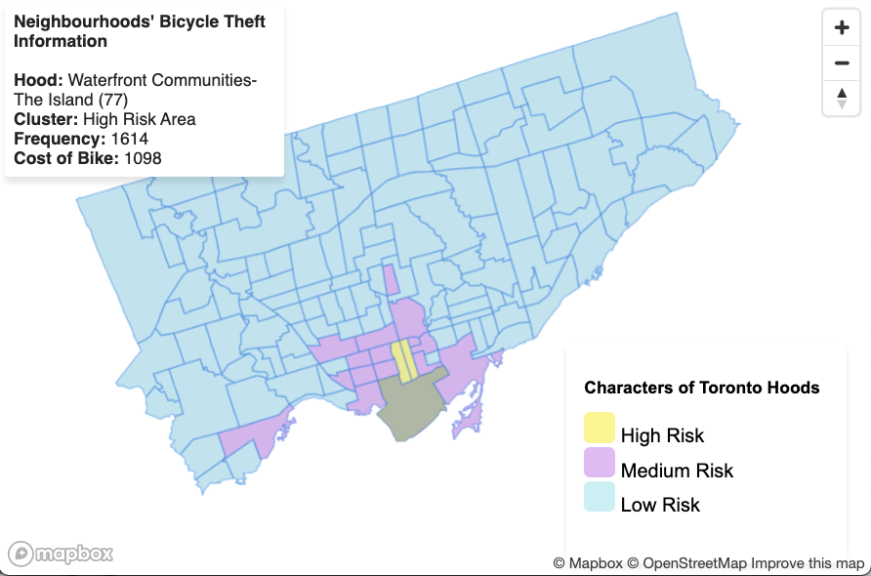
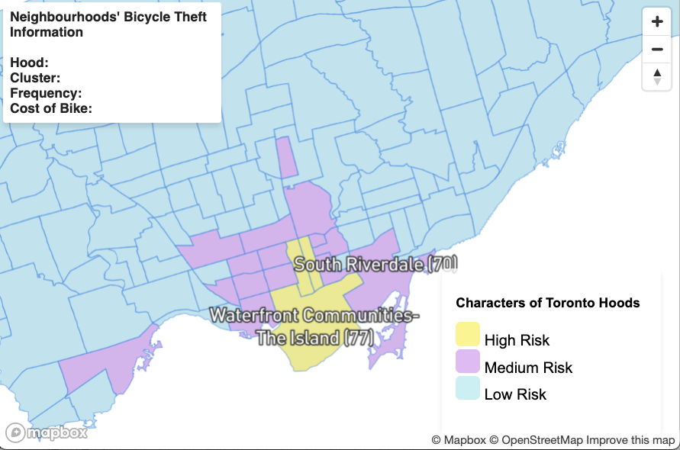
1. Bicycle Theft Characters
Notes:
overview of the clustering
blue area domain in the city of Toronto
hover effect
when mouse move on these neighbourhood area, there are further details for this hood displaying in the top-left side bar
zoom in
you can focus on several hoods such as seventy seven waterfront, the label will display on the screen automatically
you can easily find which cluster neighbourhoods belong to
the category is labeled by different colours

Slide 8
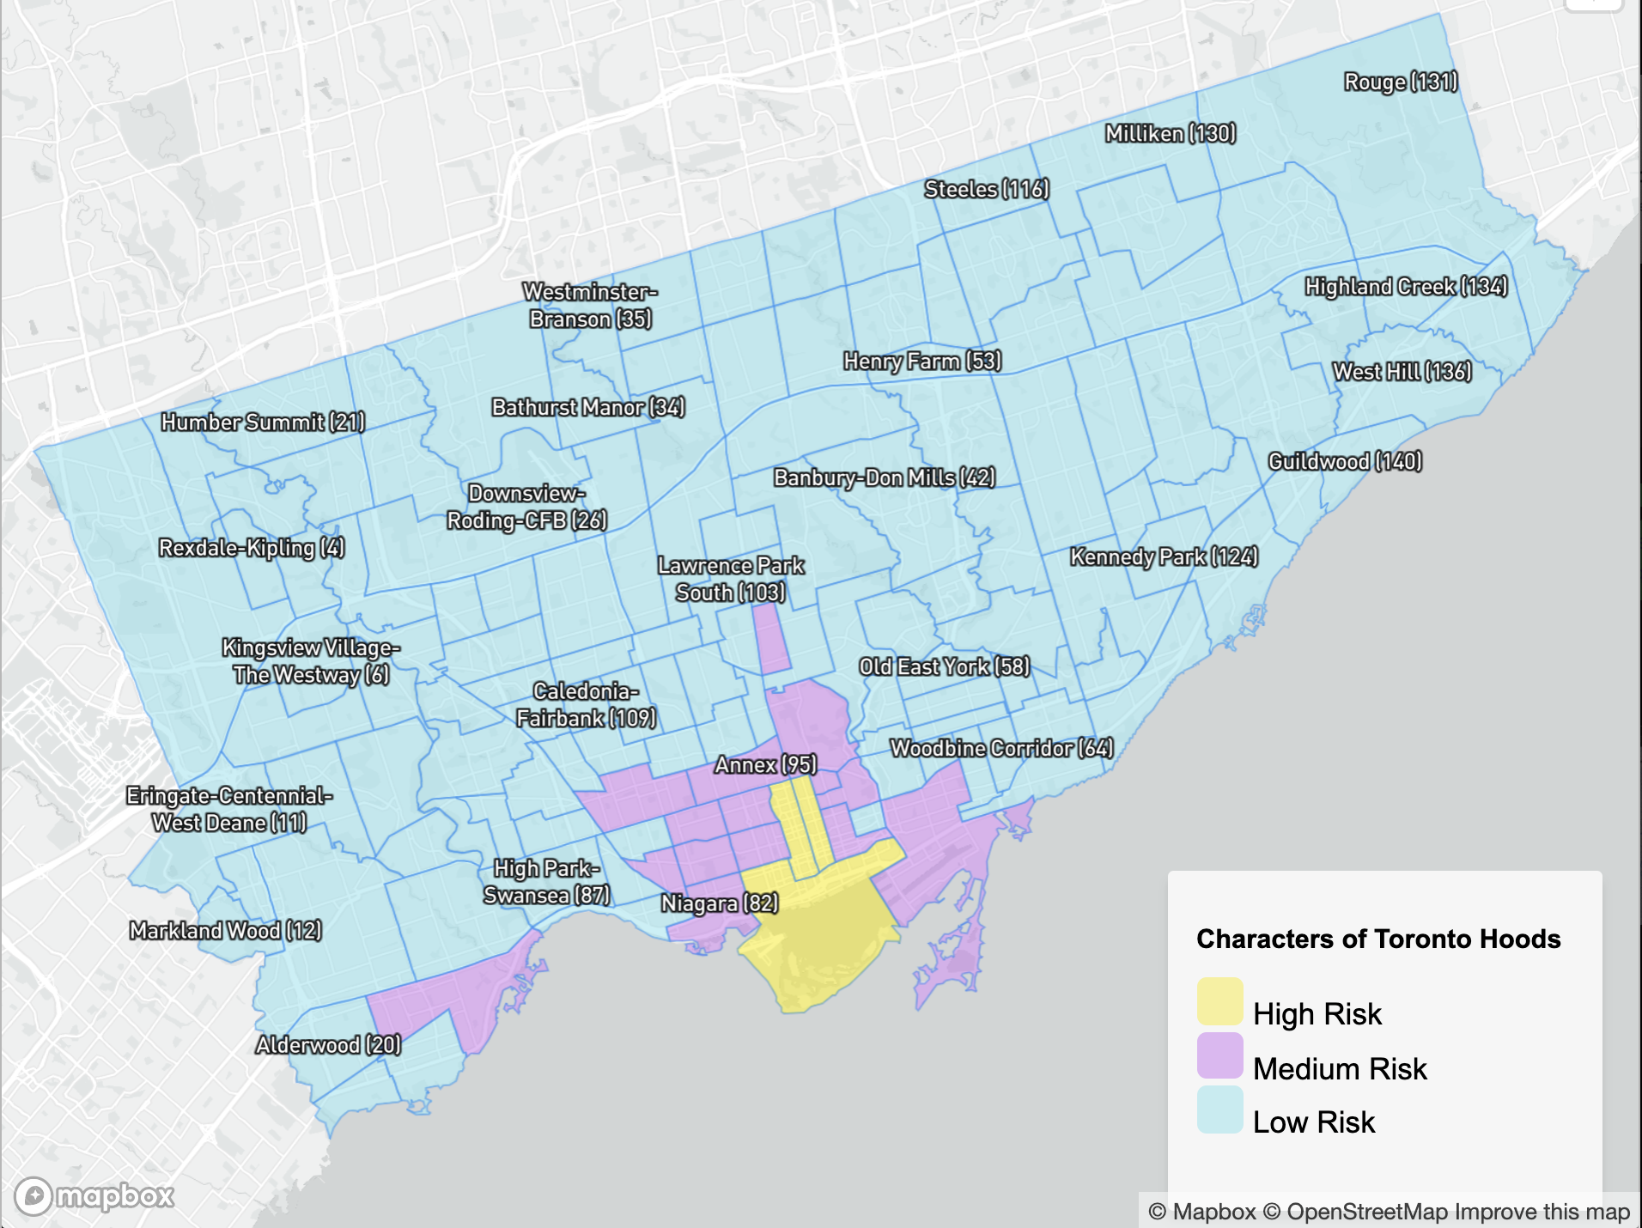
1. Bicycle Theft Characters
Category | Colour (Map) | Cost (Bike) | Frequency (Theft) | Count
Low Risk level Cheap Bike | Blue | 1003 | 43 | 120
Medium Risk level Expensive Bike | Purple | 1050 | 346 | 16
High Risk level Medium-Price Bike | Yellow | 1037 | 1287 | 3
How to protect citizen's bicycle?
Characters of Bicycle Theft Cases from 140 Neighbourhoods in the city of Toronto, Canada
Cycling infrastructure can help
Notes:
You can easily find the main characters in this table:
...
How to protect bicycles?
Parking infrastructure is matter -> ...

Slide 9
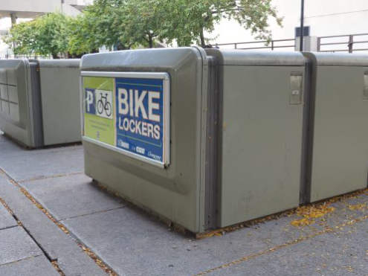
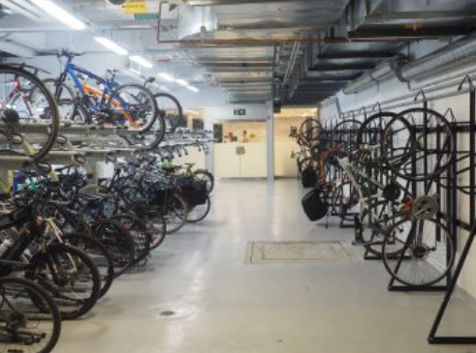
2. Bicycle Parking Infrastructure
Bicycle Lockers
Bicycle Stations
(City of Toronto, 2021)
(ibid, 2021)
Notes:
Policy ?
Parking - 1 year?

Slide 10
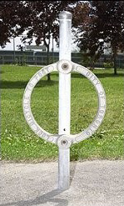
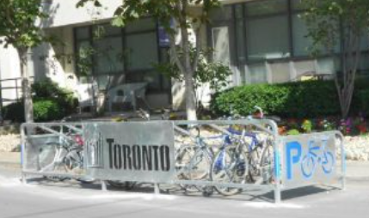
2. Bicycle Parking Infrastructure
Bicycle Corrals
Bicycle Lock-up Rings (Post and Ring)
(City of Toronto, 2021)
(ibid, 2021)
Notes:
Policy ?
Parking - 1 year?

Slide 11
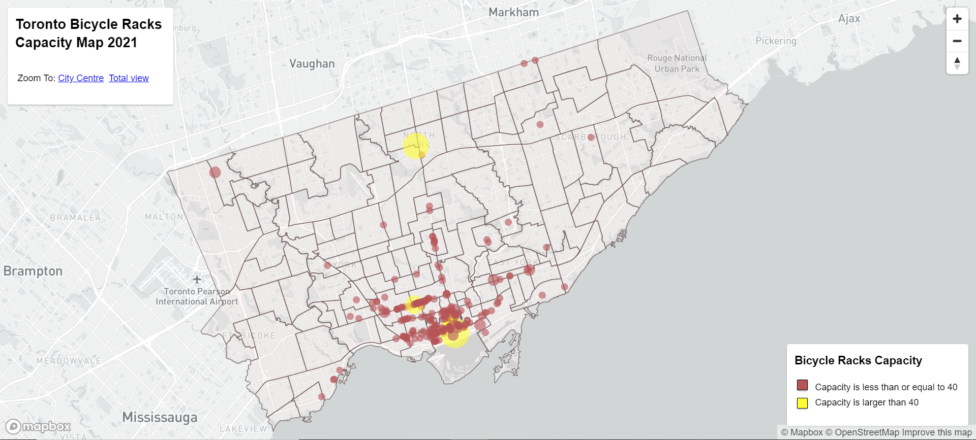
2. Parking Capacity
Permanent and seasonal multi-capacity bicycle parking racks
Notes:
Policy ?
Parking - 1 year?

Slide 12
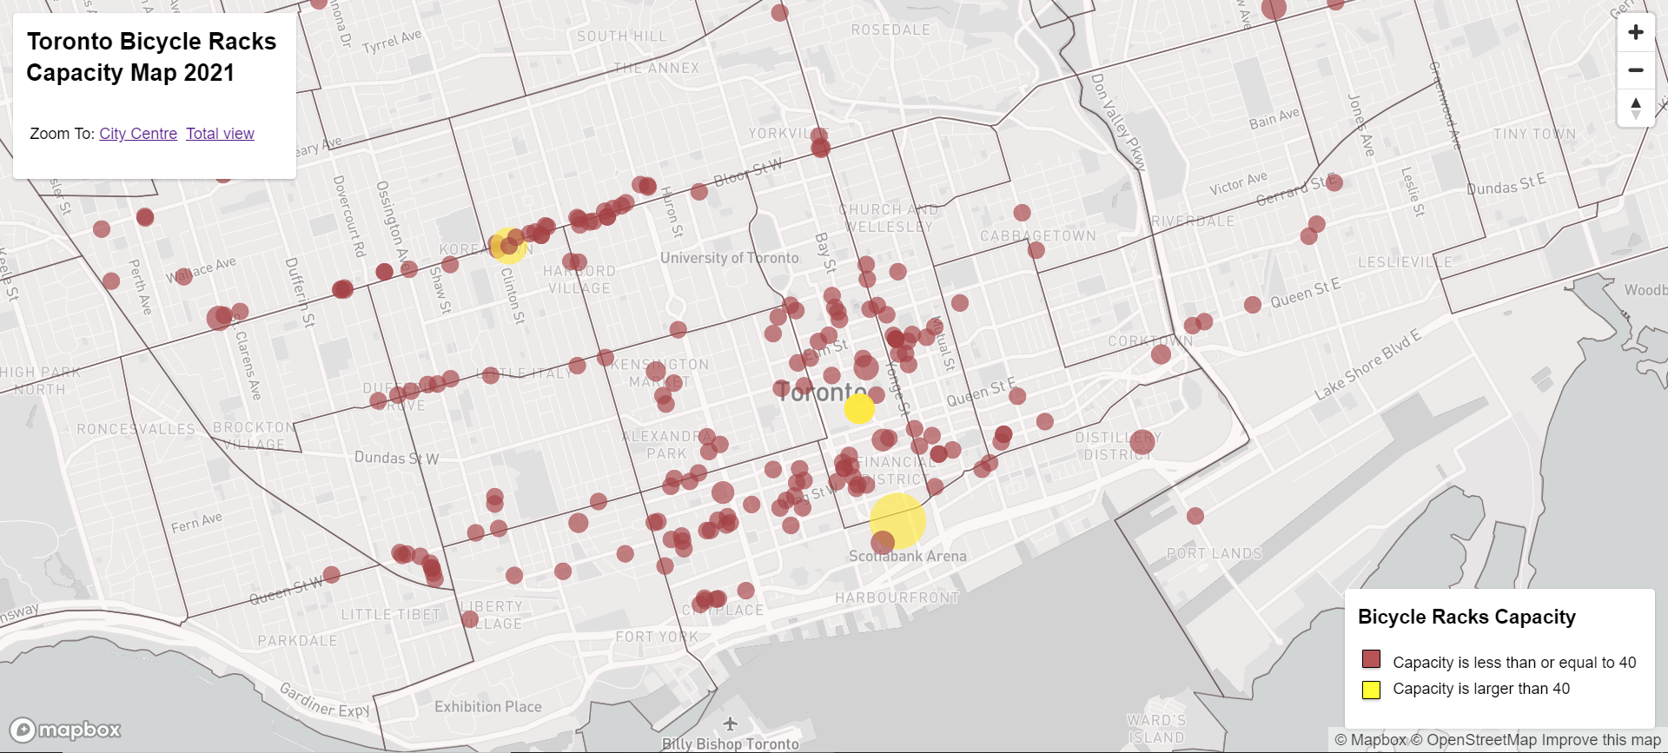
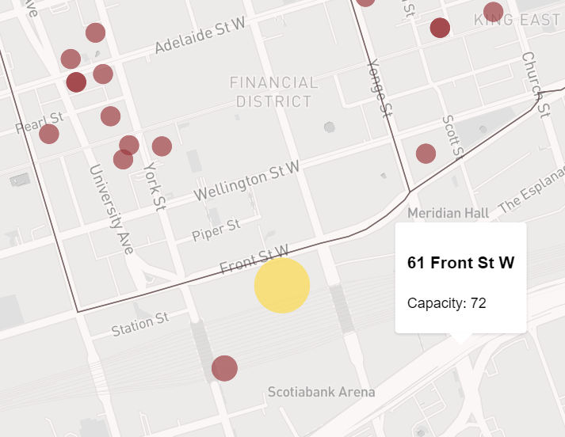
2. Parking Capacity

Slide 13
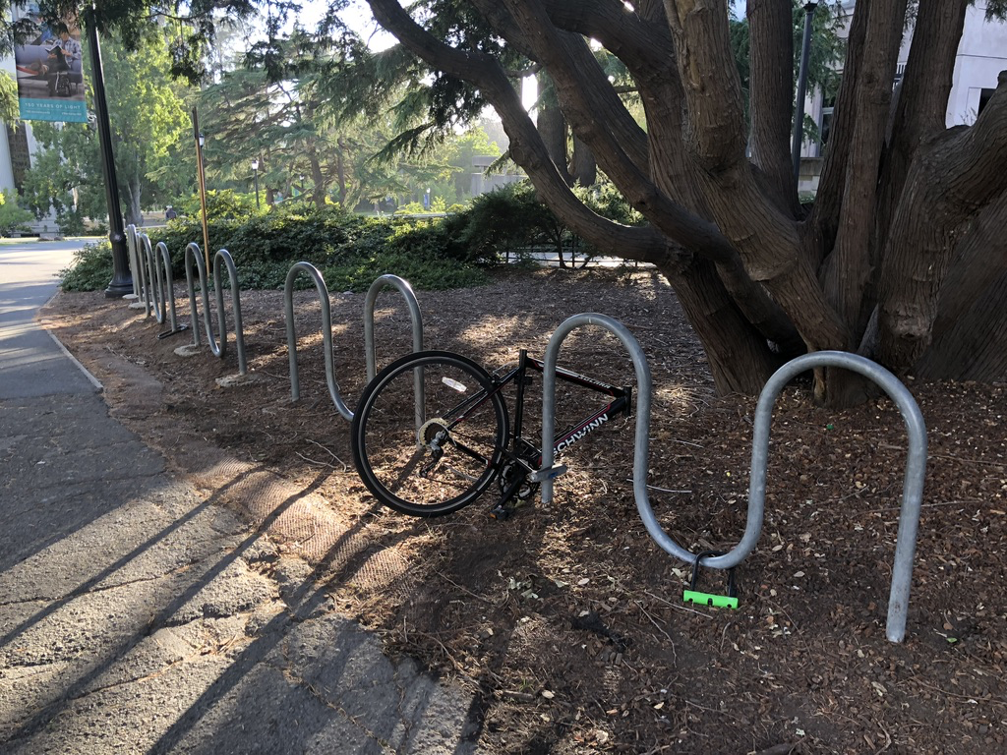
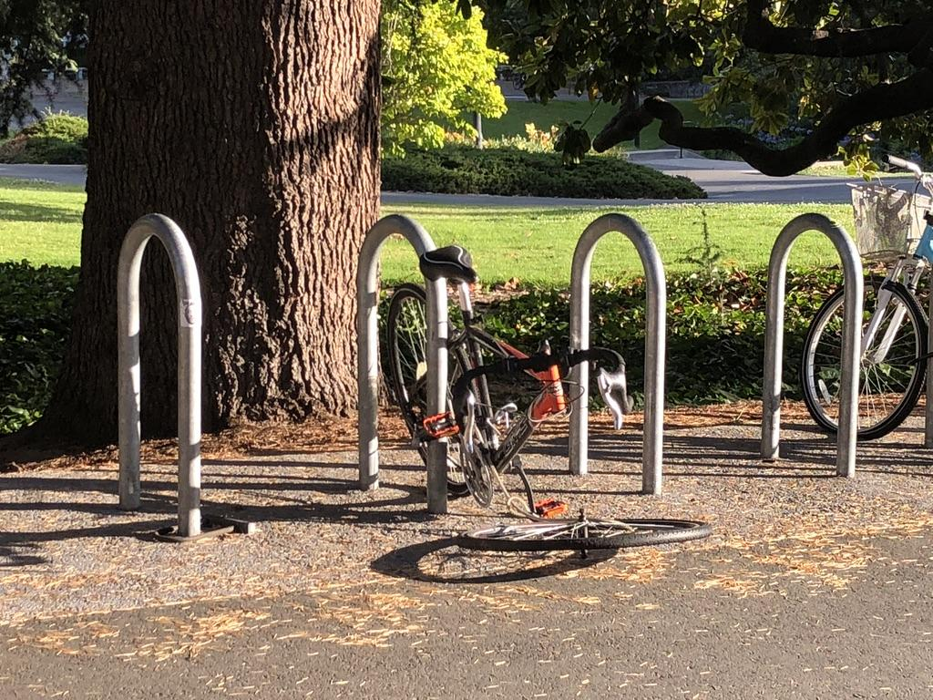
2. Parking Limitations
(Photograph by Zeqiang in Toronto, 2018)
Waste of the prime areas in city centre
Bad influence on the city appearance
Cannot stop the theft case happen totally
We need a new cycling style!
More flexible and safe!

Slide 14
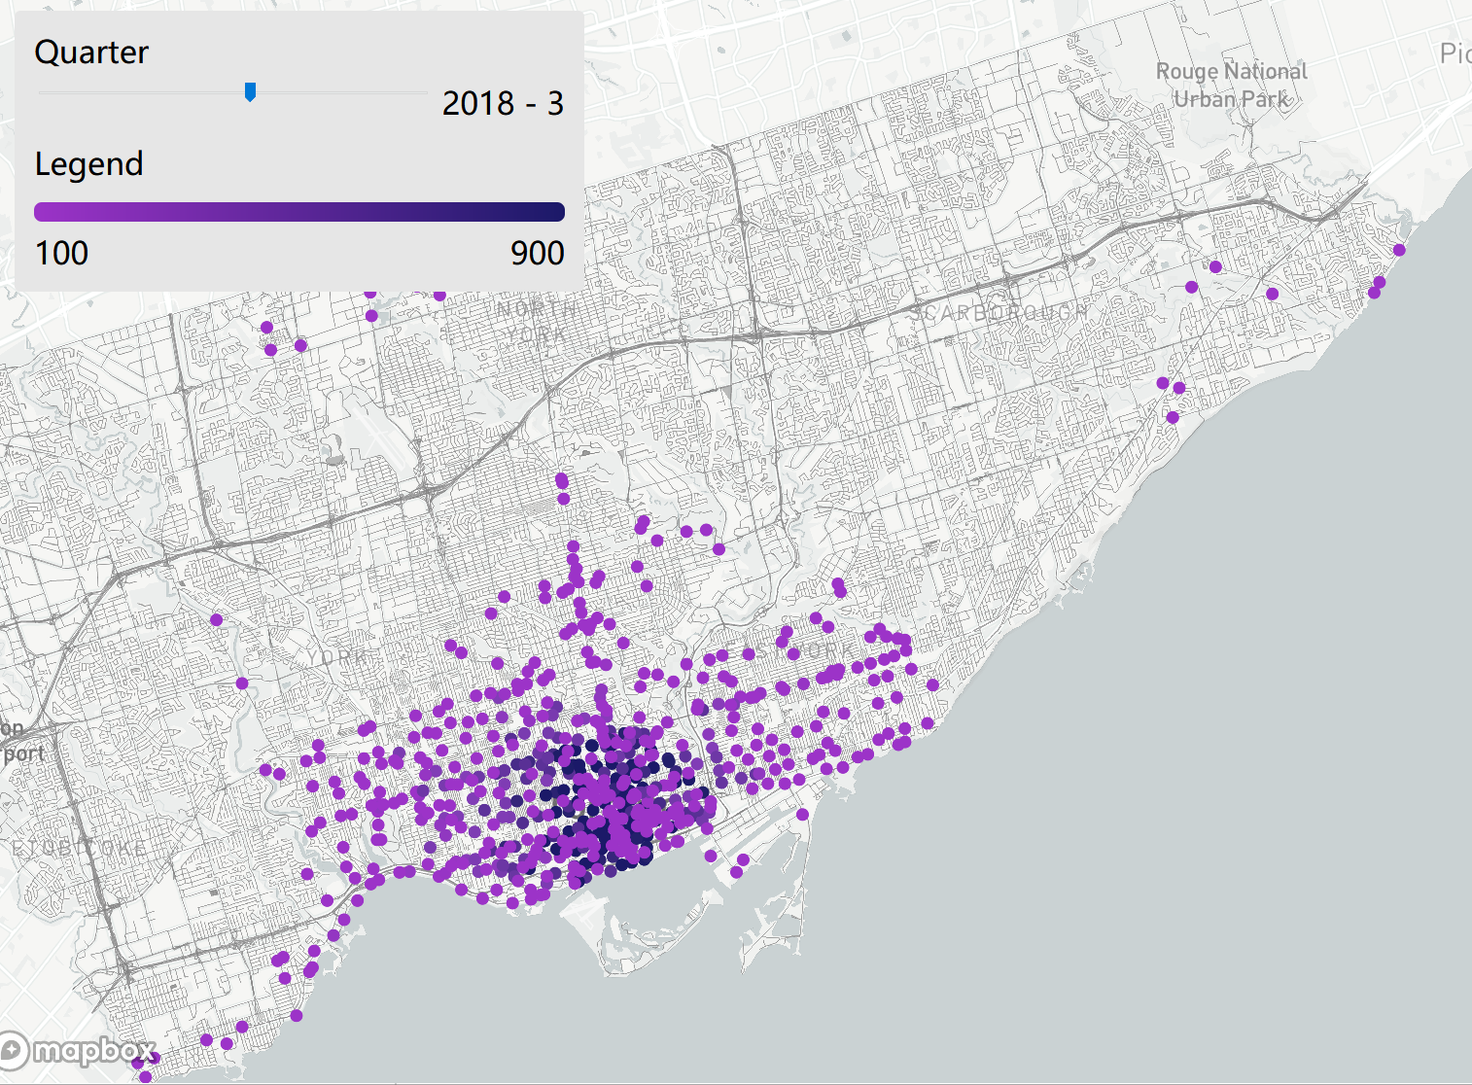
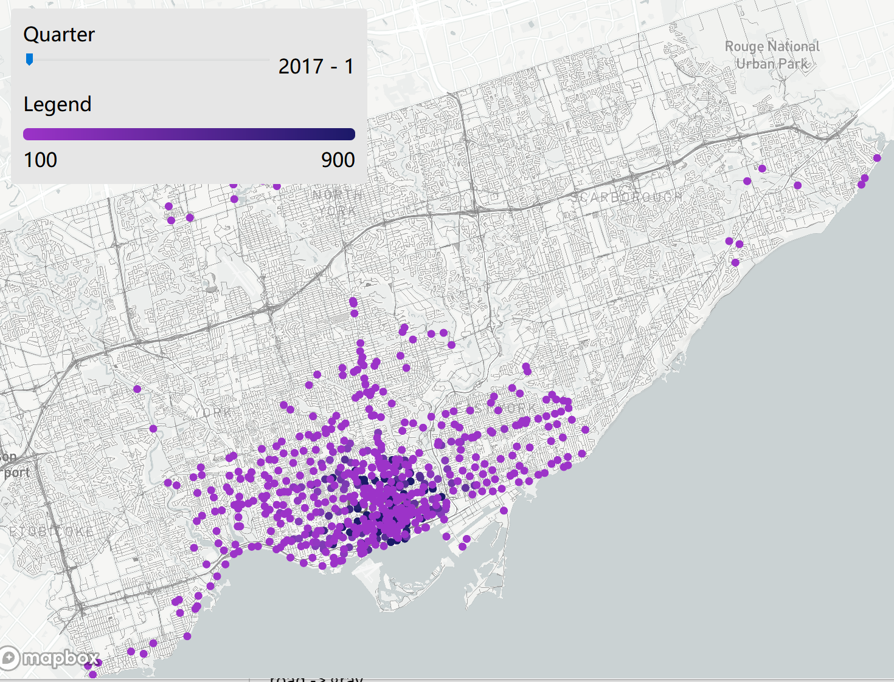
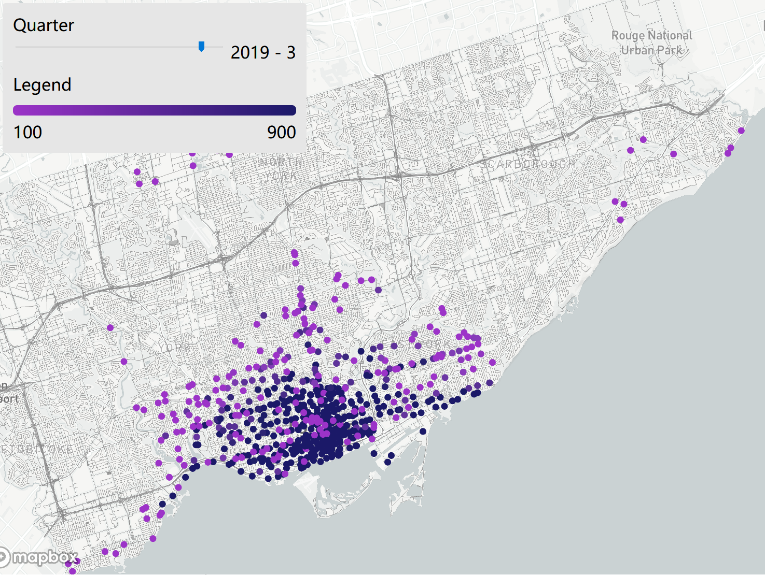
3. Share Bike Study in Toronto
Notes:
Legend
road -> gray
point -> remove the black stress outline
line chart -> auto play the change

Slide 15
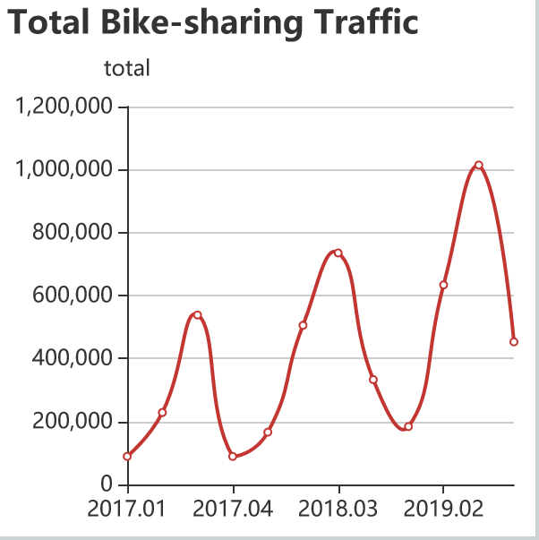
3. Share Bike Traffic Trend
Overall fluctuating upward trend
- Year-on-year increase in bike-sharing traffic in same quarter.
Cyclical trend
- The trend is based on an annual cycle.
- Extremes are reached in the third quarter of the year.

Slide 16
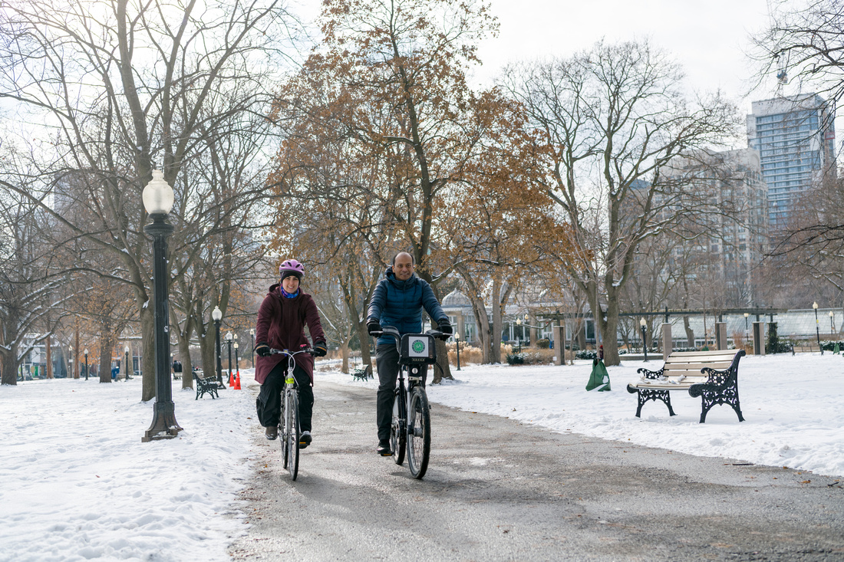
3. Cyclical Trend
(Dandy, 2018)

Slide 17

3. Policies & Investments
(Bike Share Toronto, 2020)

Slide 18
Visualisation
Work
Presentation
Notes:
Legend
road -> gray
point -> remove the black stress outline
line chart -> auto play the change

